Slide 1

INTERNET AND MOBILE PROGRAMMING

Slide 2
TABLE OF CONTENT
INTRODUCTION
TOOLS
DESIGN
IMPLEMENTATION

Slide 3
INTRODUCTION
1
Presentation of the different elements

Slide 4
For the database, many aspects were taken into consideration and we came out with the following

Slide 5
TOOLS
2
Collection of tools used

Slide 6
TOOLS
For the database, we used several tools as follows;
DJANGO
DJANGO REST FRAMEWORK
START UML

Slide 7

DJANGO
This is a high-level web framework that encourages rapid development and clean pragmatic design.

Slide 8
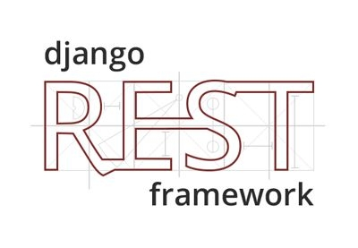
DJANGO REST FRAMEOWORK
This is a powerful flexible toolkit for building Web APIs

Slide 9

STAR UML
This is a tool for designing designing UML Diagrams

Slide 10
DESIGN
3
The database design

Slide 11
DESIGN
For the database, the design is as follows;
Class Diagram
Sequence Diagram

Slide 12
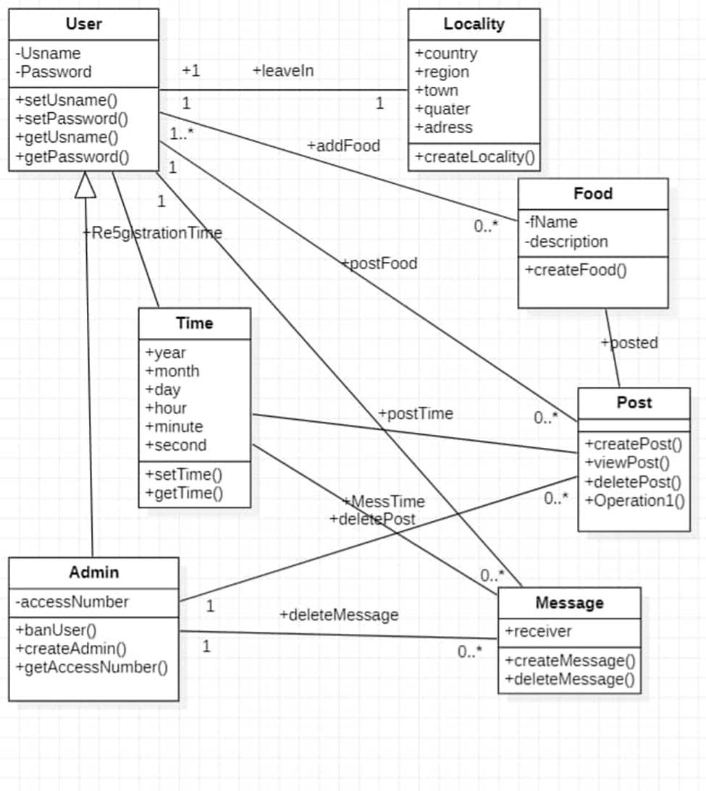
CLASS DIAGRAM

Slide 13
ENTITY RELATIONSHIP DIAGRAM

Slide 14
IMPLEMENTATION
3
The Implementation of the design

Slide 15
IMPLEMENTATION
The implementation is as follows;
Database creation
Database access
Backend Development
Database Backup

Slide 16
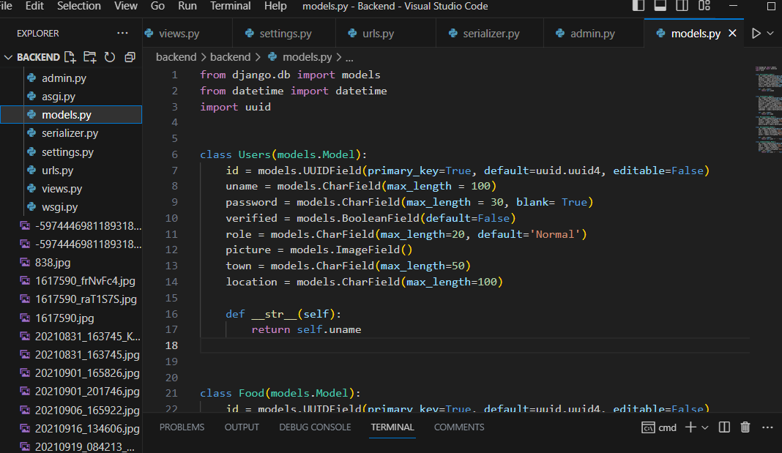
Database Creation
The create the database using Django
Which uses python as its programming
language

Slide 17
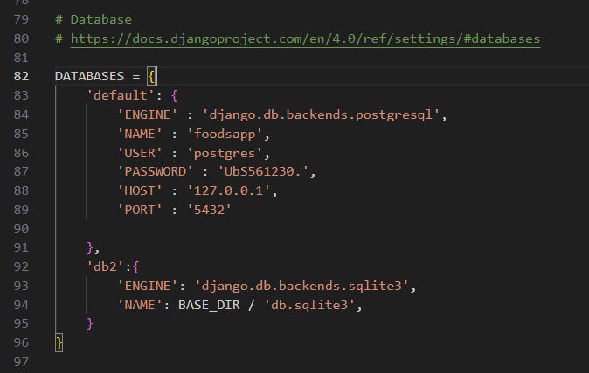
Database Access
Since the front end and the back end are desociated, we created some APIs in order for the front end to interact with the back end.

Slide 18
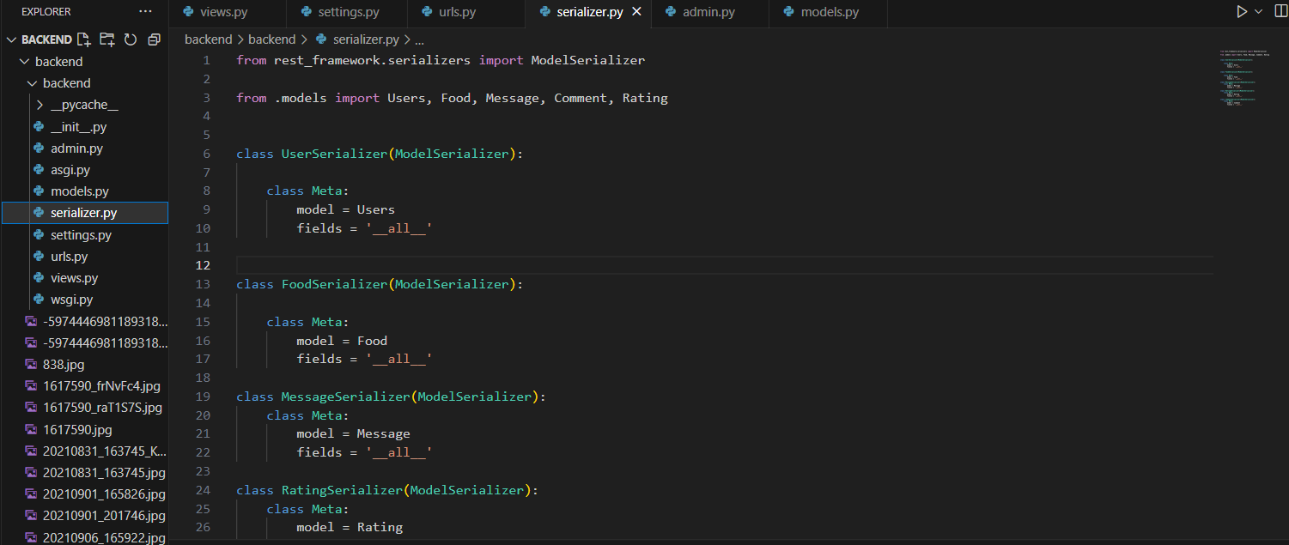
Serializer

Slide 19
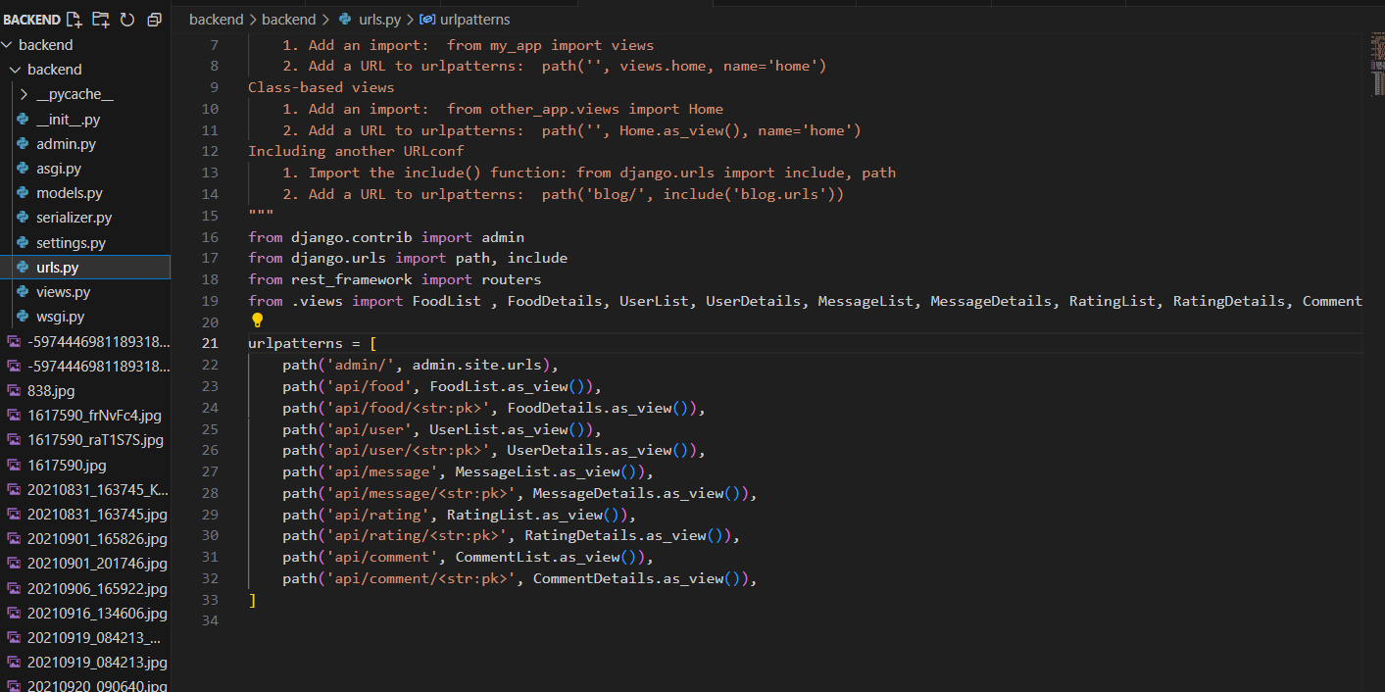
URLS Connection

Slide 20
Backend Development
All the APIs and their Endpoints was deployed on https://www.pythonanywhere.com which is a hosting platform for python projects. The administrator view is as follows

Slide 21
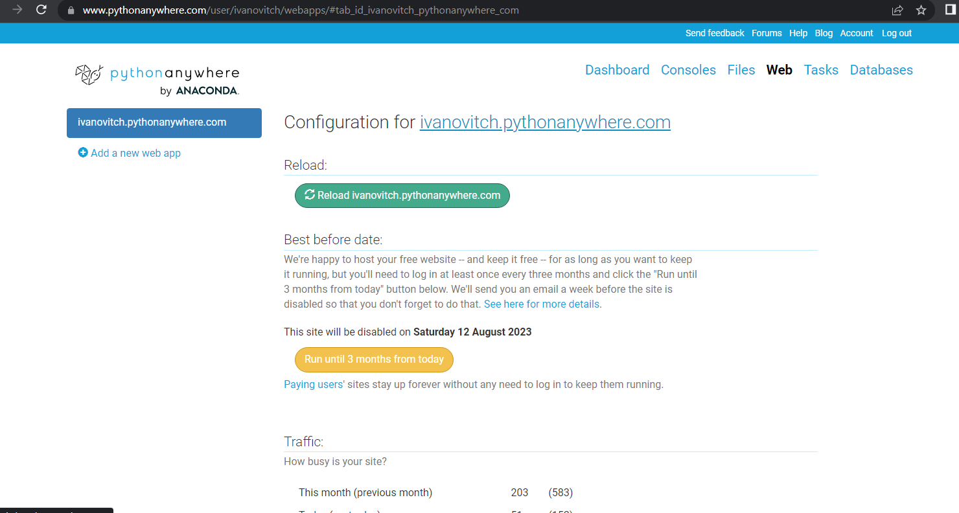
DEPLOYMENT

Slide 22
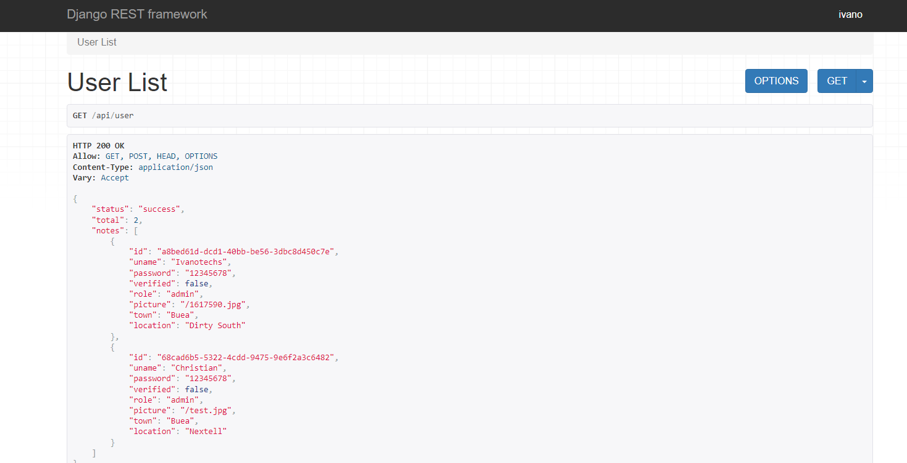
ADMIN VIEW

Slide 23
Database Backup
A second database was implementing in Postgresql and connected to our project such that each query passes through the two databases. This is a protection so as to keep track of the original database for backup in case of failure.

Slide 24
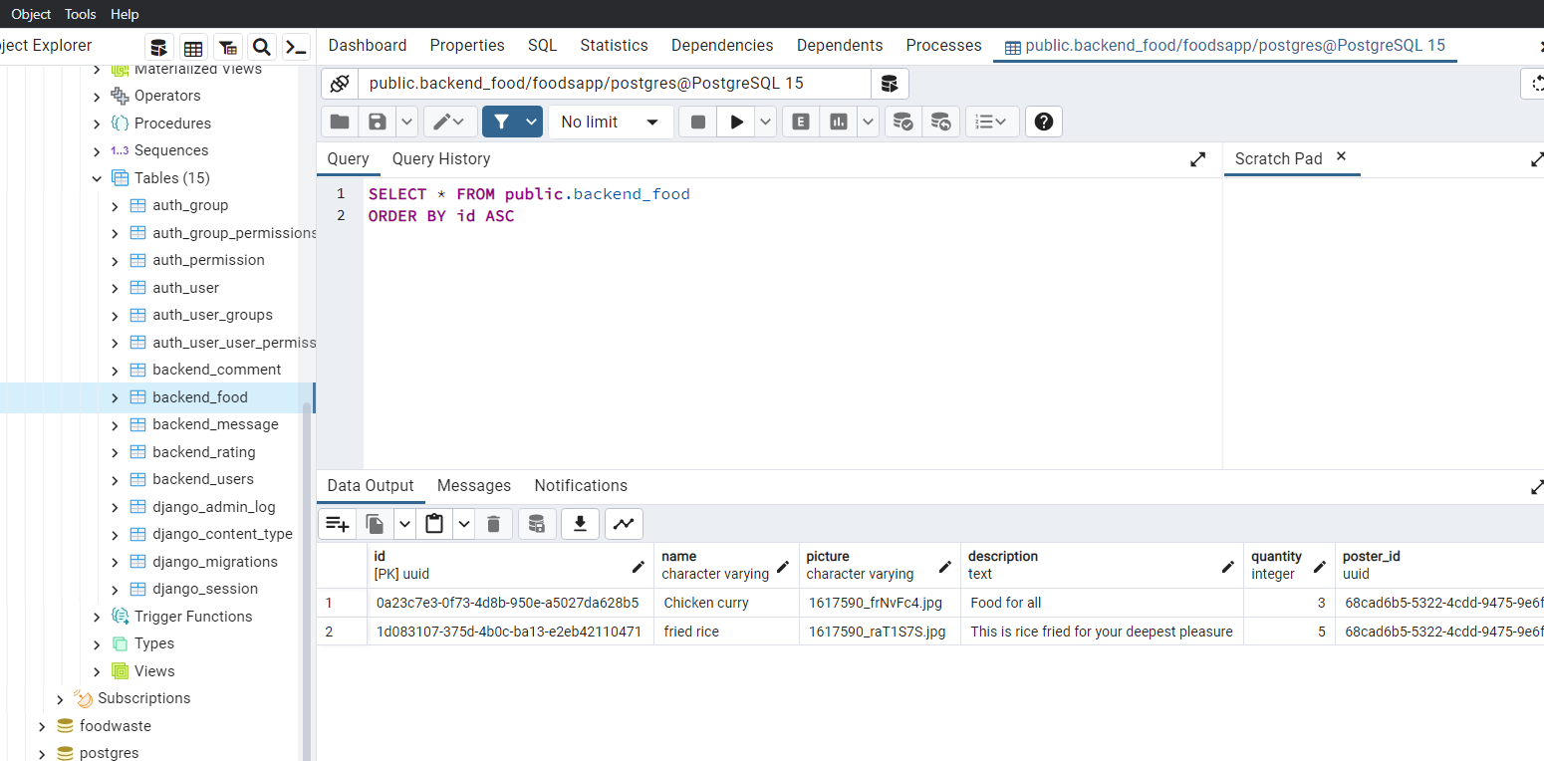
BACKUP DATABASE

Slide 25
In order to conclude, the database offers enough utilities and enable the user to use the platform easily.

Slide 26
THANKS !

